Slide 1
Infant Attachment
Jessie Marks DNP, ARNP

Slide 2
Learning objectives
Understand foundational aspects of infant-caregiver attachment
1
Understand the various types of attachment
2
Identify long term outcomes from attachment types
3
Be able to promote infant-caregiver attachment
4

Slide 3
Importance of Early Relationships
Early relationships influence brain development, determine attachment strategy, and influence infant self-awareness, emotional regulation, resiliency, and the achievement of developmental milestones (Kelly, Dillon, Larsen and Thordarson, 2013).
Relationships without nurturing attentiveness and positive caregiver responsiveness diminish the infant’s capacity and potential to develop socially and emotionally, possibly leading to future mental or behavioral disorders (Bromwhich, 1997, Shonkoff and Garner, 2012).

Slide 4

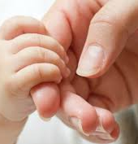
Attachment
John Bowlby introduced Attachment Theory in 1950s
Bidirectional bond between infant and caregiver
Two-way, mutually-reinforcing process
A normal developing infant will develop an attachment relationship with any caregiver who provides regular physical and/or emotional care
Not a question as to if the infant is attaching but what is the quality of attachment

Slide 5

Start of Attachment
In the last trimester of pregnancy the infant learns the mother's voice and odor
On the first day of life when an infant is crying the mother's odor and voice are soothing
Familiar maternal stimuli helps the infant transition to the outside world

Slide 6
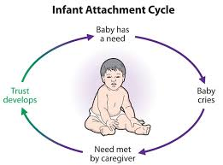

Slide 7
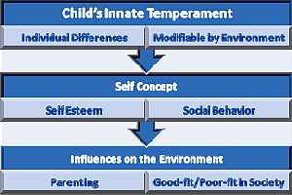
Temperament
Attachment is different than temperament
Temperament is the style in which the infant interacts with the environment

Slide 8
Types of Attachment
Quality of caregiving |  |  | Type of attachment
Sensitive | Loving | → | Secure
Insensitive | Rejecting | → | Insecure-avoidant
Insensitive | Inconsistent | → | Insecure-resistant
Atypical | Atypical | → | Insecure-disorganized

Slide 9

Secure Attachment
Infant feels confident attachment figure will meet needs
Use caregiver as safe base to explore environment
Infant seeks caregiver when distressed and are easily soothed
Infants develop a secure attachment when the caregiver is sensitive and responds to their needs

Slide 10

Insecure avoidant attachment
Emotionally and physically independent of attachment figure
Infant or child does not seek caregiver when distressed
Caregiver is likely insensitive and rejecting needs
Caregiver is unavailable during times of emotional distress

Slide 11

Insecure resistant attachment
Ambivalent behavioral style
Infant or child will have clingy or dependent behavior (difficulty with exploring new surroundings)
Will reject the caregiver when engaging in interaction
Infant does not have feelings of security
Difficult to soothe when distressed
Primary caregiver has inconsistent response to infant's needs

Slide 12
Disorganized attachment
Caregiver’s behavior is unpredictable
Resulting in no organized strategy that allows the infant or child to have their needs met without fright and terror
The first impulse of the infant is to seek comfort from the caregiver but as they get near, they fear their proximity
These infants and children are
More vulnerable to stress
Have issues with regulation of negative emotions
Display aggressive behavior

Slide 13
Long Term Outcomes
Secure attachment to a caregiver acts as a protective factor against social and emotional insecurities
Attachment insecurity (avoidant and resistant) is a risk factor for future psychopathology
Disorganized attachment in infancy is a powerful predictor for serious psychopathology and maladjustment in children

Slide 14
Promoting Infant-Caregiver Attachment
Help
Help pregnant women improve mental and emotional health in pregnancy
Educate
Educate caregivers on the influence and significance of the relationship with their infant
Identify
Identify infant-caregiver relationships that have tension and negative interchanges placing infants at risk for negative developmental trajectories.
Change
Change negative developmental trajectories to more positive ones through reframing parental perceptions and reactions

Slide 15
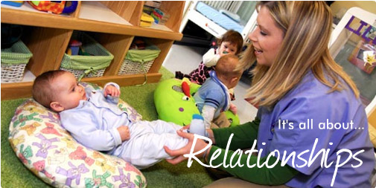
Assessment of a Healthy Relationship
How well does the caregiver respond and adapt to the infant's needs?
Does the caregiver delight in the infant? Does the infant delight in the caregiver?
Is the caregiver sensitive to the developmental level of the infant?

Slide 16
The Barnard Center for Infant Metal Health and Development
Research: Randomized clinical trials on home visiting programs
Dissemination: Parent-Child Relationship Programs
Workforce development: Train professionals that work with families
https://nursing.uw.edu/research/programs/barnard-center/

Slide 17
Parent-Child Programs
Promoting Maternal Mental Health During Pregnancy
Promoting First Relationships® in Pediatric Primary Care

Slide 18

Promoting First Relationships Consultation Strategies
Joining Process
Strength-based Positive Feedback
Positive Instructive Feedback
Support Caregiver Reflection Capacity
(Kelly, Dillon, Larsen, and Thordarson, 2013)

Slide 19
Well Child Visits
Assess
Assess Infant-Caregiver Relationship
Focus on
Focus on key developmental and social-emotional issues for each visit.
Provide
Provide anticipatory guidance at the most appropriate time
Join
Join with parents and provide positive and instructive feedback as well as reflective questions.

Slide 20
References
Sullivan, R., Perry, R., Sloan, A., Kleinhaus, K., & Burtchen, N. (2011). Infant bonding and attachment to the caregiver: insights from basic and clinical science. Clinics in perinatology, 38(4), 643-55.
Benoit D. (2004). Infant-parent attachment: Definition, types, antecedents, measurement and outcome. Paediatrics & child health, 9(8), 541-545.
McLeod, S. A. (2018, August 05). Mary Ainsworth. Retrieved from https://www.simplypsychology.org/mary-ainsworth.html
Sumner, G. and Spietz, A. (1994). NCAST Caregiver/Parent-Child Interaction Feeding Manual. NCAST Publications. Seattle: University of Washington.
Kelly, J. F., Dillon, C. O., Larsen, J. M. and Thordarson, N. O. (2013). Promoting First Relationships in Pediatric Primary Care. NCAST Programs, University of Washington.
Kraft, C. (2013). Buiding Brains, Forging Futures: A call to action for the family-centered Medical Home. Zero to Three. 34 (1), 16-20.

